Slide 1

Memory
Jerry Lebowitz

Slide 2
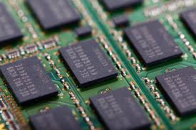
Computer Memory

Slide 3
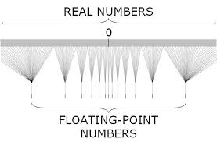
Topics
Storing Integers
Fixed Point
Floating Point

Slide 4

Computer Memory
All numbers are stored using bits (on or off)
Binary
Computers must deal with discrete values

Slide 5
<Climits>
#include <iostream>
#include <climits>
using namespace std;
int main()
{
cout << "Number of bits in a byte " << CHAR_BIT << endl;
cout << "Maximum char value " << CHAR_MAX << endl;
cout << "Minimum char value " << CHAR_MIN << endl;
cout << "Maximum short value " << SHRT_MAX << endl;
cout << "Minimum short value " << SHRT_MIN << endl;
cout << "Maximum int value " << INT_MAX << endl;
cout << "Minimum int value " << INT_MIN << endl;
cout << "Maximum long value " << LONG_MAX << endl;
cout << "Minimum long value " << LONG_MIN << endl;
cout << "Maximum long long value " << LLONG_MAX << endl;
cout << "Minimum long long value " << LLONG_MIN << endl;
cout << "Maximum unsigned char value " << UCHAR_MAX << endl;
cout << "Maximum unsigned short value " << USHRT_MAX<< endl;
cout << "Maximum unsigned int value " << UINT_MAX << endl;
cout << "Maximum unsigned long value " << ULONG_MAX << endl;
return 0;
}
*system dependent

Slide 6
<Climits>
Number of bits in a byte 8
Maximum char value 127
Minimum char value -128
Maximum short value 32767
Minimum short value -32768
Maximum int value 2147483647
Minimum int value -2147483648
Maximum long value 2147483647
Minimum long value -2147483648
Maximum long long value 9223372036854775807
Minimum long long value -9223372036854775808
Maximum unsigned char value 255
Maximum unsigned short value 65535
Maximum unsigned int value 4294967295
Maximum unsigned long value 4294967295
*system dependent

Slide 7
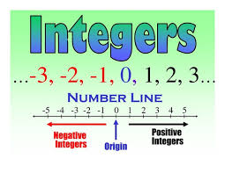
Range of Integers
Number of Bits | Range of Positive integers | Two Complement Integers
8 | 0 - 255 | (-128 ) - 127
16 | 0 - 65,535 | (-32,768) - 32,767
32 | 0 - 4,294,967,295 | (– 2,147,483,648) - 2,147,483,647
-28 decimal is 1110 0100 (binary) or E4 (hex)
(28 = 0001 1100 -28 (1110 0011) – twos complement (add 1) is 1110 0100 )

Slide 8
More Decimal to Binary (hex) Examples
Assuming 32 bit integer
Show -88 (decimal) in 2’s complement and hex
111111111111111111111111 1010 1000 = FFFFFFA8
88=64+16+8
Show -4B (hex) in 2’s complement and hex
111111111111111111111111 1011 0101 = FFFFFFB5

Slide 9

Binary Coded Decimals (BCD)
Main virtue is a more accurate representation and rounding of decimal quantities
Very useful when dealing with $$$ (dollars and cents)
Each decimal digit requires 4 bits
(0)0000 – (9)1001
Common to store two BCD digits in 1 byte (called packed BCD)
Requires an extra nibble (4 bits) to indicate sign

Slide 10
BCD Example (Fixed point)
When storing values between plus or minus $9,999,999.99
5 bytes of storage will be needed
-4,325,120.25
0001 0100 0011 0010 0101 0001 0010 0000 0010 0101 or
14 32 12 51 20 25 (hex)
4,325,120.25
0000 0100 0011 0010 0101 0001 0010 0000 0010 0101 or
04 32 12 51 20 25 (hex)
Decimal point is always fixed at a particular number of places (not actual stored)
BCD is okay if the numbers do not get too large or too small
In these cases, best to use scientific notation

Slide 11
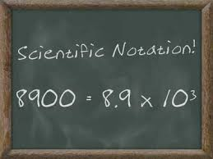
Scientific Notation
4.9 x 10¹¹
4.9 is called the mantissa or significand (magnitude always greater or equal to one and less than 10
Referred to as normalized form

Slide 12
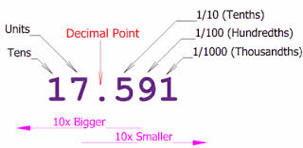
Decimal Numbers
12345.67 = 1 x 10⁴ + 2 x 10³ + 3 x 10² + 4 x 10¹ +5 x 10⁰ + 6 x 10⁻¹ ⁺ 7 x 10⁻²
(Powers of 10)
We will use a similar decomposition when using binary

Slide 13
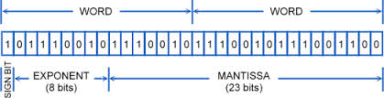
Floating Point Example (Binary to Decimal)
Representing fractions
101.1101 (powers of 2)
=2^2+2^0+2^-1+2^-2+2^-4 = 5.8125
101.1101
The normalized binary floating point is 1.011101 x 2²

Slide 14
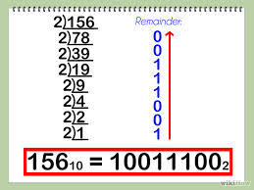
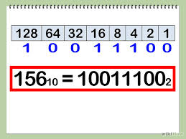
Floating Point Example (Decimal to Binary)
5.8125 = 2² + 2⁰ + 2⁻¹ + 2⁻² + 2⁻⁴ ⁼ 101.1101 or 1.011101 x 2²

Slide 15

Floating Point
Use IEEE (institute of Electrical and Electronics Engineers) standards
Two formats
Single precision - 4 bytes (float)
Double precision - 8 bytes (double)

Slide 16
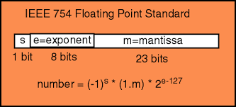
Single Precision (Four Bytes)
S = 1 Bit Sign e = 8-Bit Exponent f = 23-Bit Significand Fraction
Because the significand always has a one to the left of the binary point (normalized), it is not included in storage in the IEEE standard

Slide 17
Single Precision Explained
The eight bit exponent ranges from 0 to 255
Biased exponent (must subtract the bias (127))
If the exponent is between 1 – 254
(-1)^{s} x 1.f x 2^{e-127}
s – sign bit, f – significand, e – exponent
If s is 0 implies the number is positive
If s is 1 implies the number is negative
1.f
1 followed by a binary point followed by a 23 bit significand
The exponent – power of 2 (is biased by 127)

Slide 18
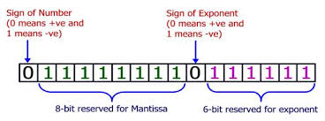
Decimal to Floating Point Example
Covert 1 10000011 10100000000000000000000 (single precision floating point notation) to decimal
1 -> negative
10000011 ->131 – 127 = 4 -> (2⁴)
10100000000000000000000 -> 2⁻¹ + 2⁻³
- (1+ 2⁻¹ + 2⁻³)*2⁴ ⁼ -26

Slide 19
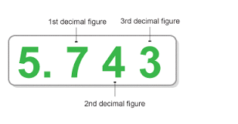
Floating Point to Decimal Example
Store 7.75 in single precision floating point notation (show the hex)
7.75=2²+2¹+2⁰+2⁻¹+2⁻²=111.11_{two}
111.11_{two}=1.1111_{two*}2²
S = 0
e = 2+127=129 = 10000001
f = 11110000000000000000000
Floating point
0 10000001 11110000000000000000000 = 40F80000

Slide 20
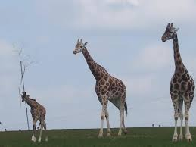
Single Precision Details (1)
The smallest normalized positive or negative number is
1.00000000000000000000000_{two} x 2⁻¹²⁶
1.175 x 10⁻³⁸
0 00000001 00000000000000000000000

Slide 21
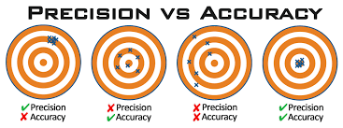
Single Precision Details (2)
The largest normalized positive or negative number is
1.11111111111111111111111_{two} x 2¹²⁷
0 11111110 11111111111111111111111
3.40 x 10³⁸
2²³ (8.38M) is approximately equal to 10⁷ (7 digits) – single precision accuracy

Slide 22
Single Precision – Special Cases
If e = 0, f = 0, s = 0 implies the number is 0
If e = 0, f = 0, s = 1 implies the number is a very small number that cannot be represented with the available digits and exponents (negative 0)
If e = 0, f != 0, the number is valid but not normalized
(-1)^{s} x 0.f x 2⁻¹²⁷
If e = 255, f = 0, the number is positive or negative depending on the sign of s
If e = 255, f != 0, the number is not valid (NAN – not a number)

Slide 23
Single Precision Accuracy Example
Accurate to 2²⁴ or 1 part in 16,777,216
This implies that 16,777,216, 16,777,216.5, and 16,777,217 are identical using single precision
0 10010111 00000000000000000000000 (4B800000 (hex)) – exponent is 151-127=24
Which is 1.00000000000000000000000_{two} x2²⁴
The next number is 1.00000000000000000000001_{two} x2²⁴
(1+2⁻²³)x2²⁴= 16,777,218
Cannot store unique numbers between 16,777,216 and 16,777,218
This can be a real problem especially when dealing with large $$$$ amounts

Slide 24
Double Precision (Eight Bytes)
S = 1 Bit Sign e = 11-Bit Exponent f = 52-Bit Significand Fraction
Because the significand always has a one to the left of the binary point, it is not included in storage in the IEEE standard
53 bits implies approximately 16 decimal digits of precision (10⁻³⁰⁸ to 10³⁰⁸)

Slide 25
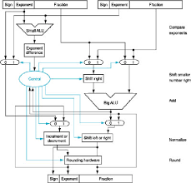
Floating Point Addition
(1.1101x 2⁵) + (1.0010 x 2²)
Must aligned the binary point
111010.0 + 100.10 = 111110.10 = 1.1111010 x 2⁵ = 62.5

